Slide 1
Chapter 9: Estimation Theory
Fundamentals
Minimum Variance Unbiased (MVU) Estimators
Maximum Likelihood (ML) Estimation
Spectral Estimation

Slide 2
References
[1] Simon Haykin, Adaptive Filter Theory, Prentice Hall,
1996 (3rd Ed.), 2001 (4th Ed.).
[2] Steven M. Kay, Fundamentals of Statistical Signal Processing: Estimation Theory, Prentice Hall, 1993.
[3] Alan V. Oppenheim, Ronald W. Schafer, Discrete-Time Signal Processing, Prentice Hall, 1989.
[4] Athanasios Papoulis, Probability, Random Variables, and Stochastic Processes, McGraw-Hill, 1991 (3rd Ed.), 2001 (4th Ed.).

Slide 3
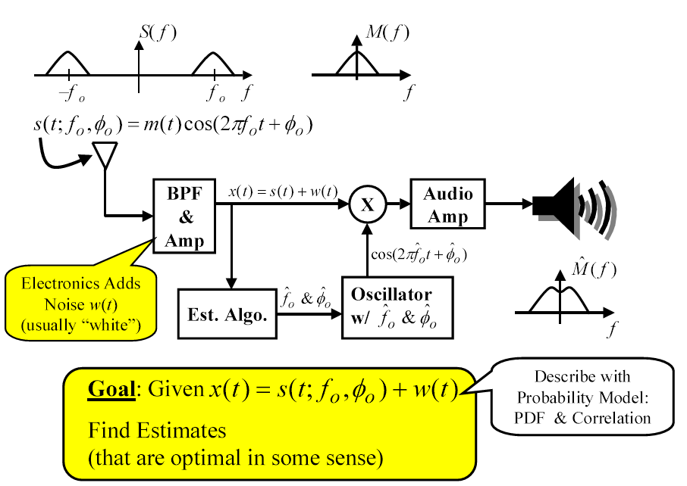
9. Fundamentals (1)
An example estimation problem: DSB Rx

Slide 4
9. Fundamentals (2)
Discrete-time estimation problem: working with samples of the observed signal (signal plus noise):
Each time “observing” x[n] it contains same s[n] but different “realization” of noise w[n], so the estimate is different each time.
So, are RVs.
Our job: Given finite data set x[0], x[1], …, x[N-1], find estimator functions that map data into estimates:
These are RVs, need to describe with probability model.

Slide 5
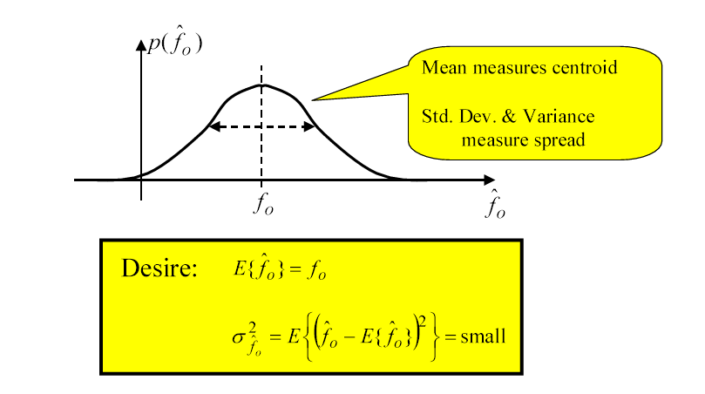
9. Fundamentals (3)
PDF of estimate: Because estimates are RVs we describe them with a PDF depending on:
structure of s[n]
probability model of w[n]
form of est. function g(x)

Slide 6
9. Fundamentals (4)
General mathematical statement of estimation problem:
For measured data x = [x[0], x[1], …, x[N-1]], unknown parameter
θ = [θ₁, θ₂ …θ_{p}]
θ is not random,
x is an N-dimensional random data vector.
Q: What captures all the statistical information needed for an estimation problem ?
A: Need the N-dimensional PDF of the data, parameterized by θ: p(x; θ).
We will use p(x; θ) to find g(x). In practice, not given PDF ! Choose a suitable model:
Captures essence of reality
Leads to tractable answer

Slide 7
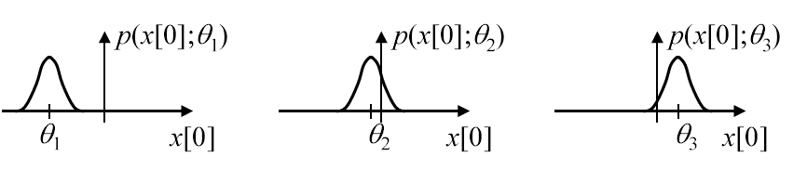
9. Fundamentals (5)
Example: Estimating a DC level in zero mean AWGN
Consider a single data point is observed: x[0] = θ+w[0], w[0] is N(0, σ²). Then, θ+w[0] is N(θ, σ²).
So, the needed parameterized PDF is: p(x[0];θ) which is Gaussian with mean of θ.
So, in this case the parameterization changes the data PDF mean:

Slide 8
9. Fundamentals (6)
Typical assumptions for noise model:
Whiteness and Gaussian are always easiest to analyze
Usually assumed unless you have reason to believe otherwise
Whiteness is usually first assumption removed
Gaussian is less often removed due to the validity of Central Limit Theorem
Zero mean is a nearly universal assumption
Most practical cases have zero mean
But if not… w[n] = w_{zm}[n] + µ
Variance of noise doesn’t always have to be known to make an estimate
But, must know to assess expected “goodness” of the estimate
Usually perform “goodness” analysis as a function of noise variance (or SNR). Noise variance sets the SNR level of the problem.

Slide 9
9. Fundamentals (7)
Classical vs. Bayesian estimation approaches:
If we view θ (parameter to estimate) as non-random → Classical Estimation, provides no way to include a priori information about θ (Minimum Variance, Maximum Likelihood, Least Squares).
If we view θ (parameter to estimate) as random → Bayesian Estimation, allows use of some a priori PDF on θ
(MMSE, MAP, Wiener filter, Kalman Filter).

Slide 10
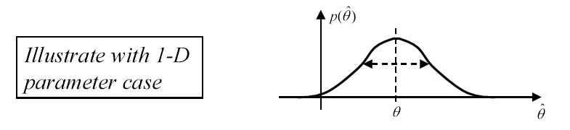
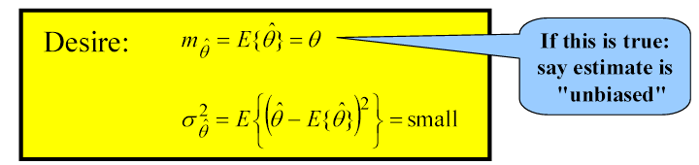
9. Fundamentals (8)
Assessing estimator performance
Can only do this when the value of θ is known: Theoretical analysis, simulations, field tests, etc.
Recall that the estimate is a random variable.
Thus it has a PDF of its own and that PDF completely displays the quality of the estimate.
Often just capture quality through mean and variance of

Slide 11
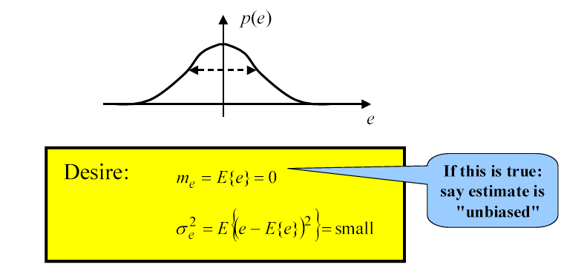
9. Fundamentals (9)
Equivalent view of assessing performance
Define estimation error: or
RV RV not RV
Completely describe estimator quality with error PDF: p(e)

Slide 12
9. Fundamentals (10)
Example: DC level in AWGN
Model: x[n] = A + w[n] , n = 0, 1, …, N-1
w[n]: Gaussian, zero mean, variance σ², white (uncorrelated sample-to-sample)
PDF of an individual data sample:
Uncorrelated Gaussian RVs are independent, so joint PDF is the product of the individual PDFs:

Slide 13
9. Fundamentals (11)
Each data sample has the same mean (A), which is the thing we are trying to estimate, we can imagine trying to estimate by finding the sample mean:
Let’s analyze the quality of this estimator:
Is it unbiased ?
Can we get a small variance ?
Unbiased!
⇒ Can make var small by increasing N!
Due to Indep.
(white & Gauss.)

Slide 14
9. Fundamentals (12)
Theoretical analysis vs. simulations
Ideally we’d like to be always be able to theoretically analyze the problem to find the bias and variance of the estimator.
Theoretical results show how performance depends on the problem specifications.
But sometimes we make use of simulations:
To verify that our theoretical analysis is correct.
Sometimes can’t find theoretical results.

Slide 15
9. Fundamentals (13)
Goal = Find “Optimal” estimators
There are several different definitions or criteria for optimality!
Most logical: Minimum MSE (Mean-Square-Error):
where: b(θ ) is the bias of estimate.

Slide 16
9. Minimum Variance Unbiased (MVU) Estimation (1)
Basic idea of MVU: Out of all unbiased estimates, find the one with the lowest variance.
Unbiased Estimators: An estimator is unbiased if
Example: Estimate DC in white uniform noise
x[n] = A + w[n], n = 0,…, N-1
Unbiased estimator:
same as before regardless of A value.

Slide 17
9. MVU Estimation (2)
Minimum variance criterion: Constrain bias to be zero find the estimator that minimizes variance. Such an estimator is termed Minimum Variance Unbiased (MVU) estimator.
Note that MSE of an unbiased estimator is the variance. So, MVU could also be called “Minimum MSE Unbiased Est.”
Existence of MVU Estimator:
Sometimes there is no MVU Estimator, it can happen 2 ways:
There may be no unbiased estimators
None of the above unbiased estimators has a uniformly minimum variance

Slide 18
9. MVU Estimation (3)
Finding the MVU estimator: Even if MVU exists: may not be able to find it.
Three approaches to finding the MVU Estimators:
Determine Cramer-Rao Lower Bound (CRLB) and see if some estimator satisfies it. (Note: MVU can exist but not achieve the CRLB)
Apply Rao-Blackwell-Lechman-Scheffe Theorem: Rare in practice!
Restrict to Linear Unbiased & find MVLU: Only gives true MVU if problem is linear.

Slide 19
9. MVU Estimation (4)
Vector Parameter: When we wish to estimate multiple parameters we group them into a vector:
Then an estimator is notated as:
Unbiased requirement becomes:
Minimum Variance requirement becomes:
For each i…
: min over all unbiased estimates

Slide 20
9. Cramer-Rao Lower Bound (CRLB) (1)
What is the Cramer-Rao Lower Bound: CRLB is a lower bound on the variance of any unbiased estimator.
If is an unbiased estimator of θ, then
The CRLB tells us the best we can ever expect to be able to do (with an unbiased estimator)

Slide 21
9. Cramer-Rao Lower Bound (CRLB) (2)
Some uses of the CRLB:
Feasibility studies (e.g. Sensor usefulness, etc.)
Can we meet our specifications?
Judgment of proposed estimators
Estimators that don’t achieve CRLB are looked down upon in the technical literature.
Can sometimes provide form for MVU estimate.
Demonstrates importance of physical and/or signal parameters to the estimation problem.
e.g. We’ll see that a signal’s BW determines delay estimate accuracy ⇒ Radars should use wide BW signals.

Slide 22
9. Cramer-Rao Lower Bound (CRLB) (3)
Estimation accuracy consideration: What determines how well you can estimate θ ?
Recall: Data vector is x: samples from a random process that depends on θ ⇒ the PDF describes that dependence: p(x; θ).
Clearly if p(x; θ) depends strongly/weakly on θ…we should be able to estimate θ well/poorly.
⇒ Should look at p(x; θ) as a function of θ for fixed value of observed data x.

Slide 23
9. Cramer-Rao Lower Bound (CRLB) (4)
Example: PDF dependence for DC level in noise
x[0] = A+ w[0]
where w[0] ~ N(0, σ²). Then the parameter-dependent PDF of the data point x[0] is:
Define: Likelihood Function (LF)
The LF = the PDF p(x; θ), but as a function of parameter θ with the data vector x fixed.
We will also often need the Log Likelihood Function (LLF):
LLF = ln{LF} =ln{ p(x; θ)}

Slide 24
9. Cramer-Rao Lower Bound (CRLB) (5)
LF characteristics that affect accuracy: Intuitively, “sharpness” of the LF sets accuracy.
Sharpness is measured using curvature:
Curvature ↑ ⇒ PDF concentration ↑ ⇒ Accuracy ↑
But this is for a particular set of data we want “in general”. So, average over random vector to give the average curvature

Slide 25
9. Cramer-Rao Lower Bound (CRLB) (6)
Theorem: CRLB for scalar parameter
Assume “regularity” condition is met:
Then
where

Slide 26
9. Cramer-Rao Lower Bound (CRLB) (7)
Steps to find the CRLB:
1. Write log 1ikelihood function as a function of θ:
ln p(x; θ)
2. Fix x and take 2nd partial of LLF:
∂²ln p(x; θ)/∂θ²
3. If result still depends on x:
• Fix θ and take expected value with respect to x
• Otherwise skip this step
4. Result may still depend on θ: Evaluate at each specific value of θ desired.
5. Negate and form reciprocal

Slide 27
9. Cramer-Rao Lower Bound (CRLB) (8)
Example: CRLB for DC in AWGN
x[n] = A+ w[n], n = 0, 1, … , N –1
where w[n] ~ N(0, σ²) and white.
Need likelihood function:
(Due to whiteness)

Slide 28
9. Cramer-Rao Lower Bound (CRLB) (9)
Now take ln to get LLF:
Now take first partial with respect to A:
Take partial again:
(Doesn’t depend on x so we don’t need to do E{.})

Slide 29
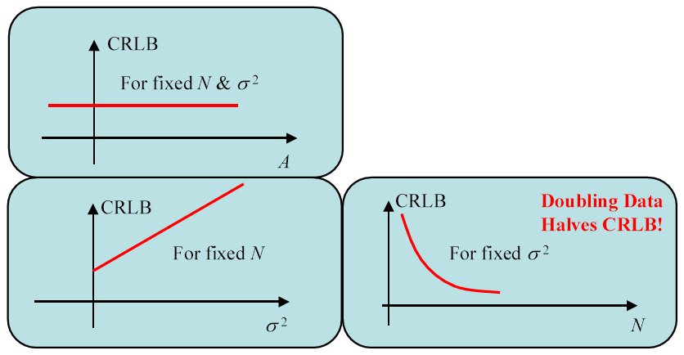
9. Cramer-Rao Lower Bound (CRLB) (10)
Since the result doesn’t depend on x or A, all we do is negate and form reciprocal to get CRLB:
Doesn’t depend on A
Increases linearly with σ²
Decreases inversely with N

Slide 30
9. Cramer-Rao Lower Bound (CRLB) (11)
Continuation of theorem on CRLB
There exists an unbiased estimator that attains the CRLB iff:
Furthermore, the estimator that achieves the CRLB is then given by:
for some functions I(θ) and g(x).
Since no unbiased estimator can do better,
this is the MVU estimate !
This gives a possible way to find the MVU:
Compute ∂ ln p(x; θ)/∂θ (need to anyway)
Check to see if it can be put in form like (**)
If so…then g(x) is the MVU estimator.

Slide 31
9. Cramer-Rao Lower Bound (CRLB) (12)
Example: Find MVU estimate for DC level in AWGN (see example slide 27)
We found in (*) that:
has the form of
where
and
So, for the DC Level in AWGN: the sample mean is the MVU Estimate !

Slide 32
9. Cramer-Rao Lower Bound (CRLB) (13)
Definition: Efficient estimator
An estimator that is:
unbiased and
attains the CRLB
is said to be an efficient estimator
Notes:
• Not all estimators are efficient (see next example: Phase estimate)
• Not even all MVU estimators are efficient

Slide 33
9. Cramer-Rao Lower Bound (CRLB) (14)
Example: CRLB for Phase Estimation
This is related to the DSB carrier estimation problem (slide 3), except here, we have a pure sinusoid and we only wish to estimate only its phase.
Signal model:
where w[n] is AWGN with zero mean and variance σ².
Signal-to-Noise Ratio (SNR):
Signal Power = A²/2, Noise Power = σ² ⇒
Assumptions:
0 < f₀< 1/2 (f₀ is in cycles/sample)
A and f₀ are known (we’ll remove this assumption later)

Slide 34
9. Cramer-Rao Lower Bound (CRLB) (15)
Problem: Find the CRLB for estimating the phase.
We need the PDF:
Now taking the log gets rid of the exponential, then taking partial derivative gives (see [2] for details):
Taking partial derivative again:

Slide 35
9. Cramer-Rao Lower Bound (CRLB) (16)
Taking the expected value:
So, plug that in, get a cos² term, use trigonometric identity, and get

Slide 36
9. Cramer-Rao Lower Bound (CRLB) (17)
CRLB for signal in AWGN:
When we have the case that our data is “signal + AWGN” then we get a simple form for the CRLB:
Signal model: x[n] = s[n;θ ] + w[n], n = 0, 1, 2, … , N-1
where: w[n] is white, Gaussian and zero mean.
First write the likelihood function:
Differentiate Log of likelihood function twice to get:

Slide 37
9. Cramer-Rao Lower Bound (CRLB) (18)
Since this equation depends on random x[n], so we must take E{}:
Therefore, CRLB for signal in AWGN:
Transformation of parameters: There is a parameter θ with known CRLB_{θ}, but now we are interested in estimating some other parameter α that is a function of θ: α = g(θ). What is CRLB_{α} ?

Slide 38
9. Cramer-Rao Lower Bound (CRLB) (19)
CRLB for vector parameter:
Vector parameter:
Its estimate:
Assume that estimate is unbiased:
For a scalar parameter we looked at its variance, but for a vector parameter we look at its covariance matrix:
Example: For θ = [x y z]^{T} then

Slide 39
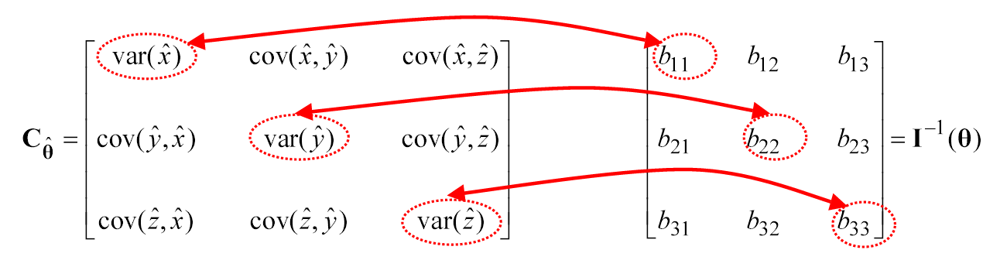
9. Cramer-Rao Lower Bound (CRLB) (20)
Fisher Information Matrix: For the vector parameter case, Fisher Info becomes the Fisher Info Matrix (FIM) I(θ), whose mn^{th} element is given by:
The CRLB Matrix: Then, under the same kind of regularity conditions, the CRLB matrix is the inverse of the FIM:
It means:

Slide 40
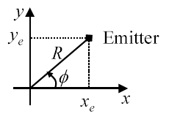
9. Cramer-Rao Lower Bound (CRLB) (21)
Vector Transformations: Just like for the scalar case α = g(θ), if you know CRLB_{θ} you can find CRLB_{α}
Example: Can estimate Range (R) and Bearing (φ) directly, but might really want to estimate emitter location (x_{e}, y_{e})

Slide 41
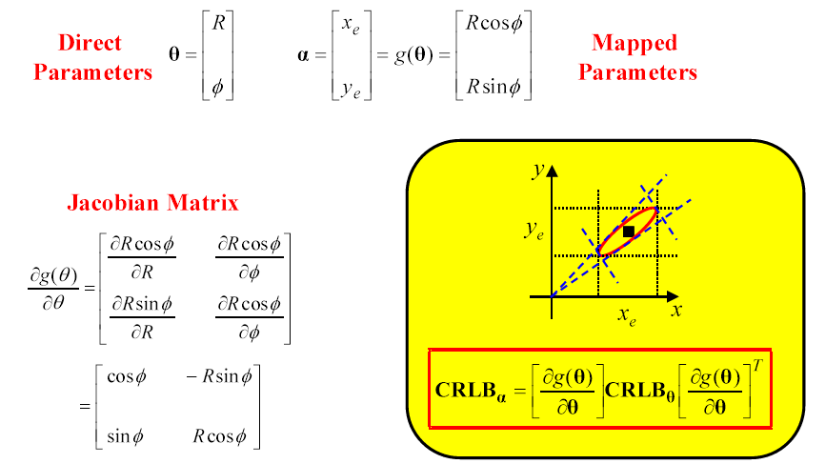
9. Cramer-Rao Lower Bound (CRLB) (22)

Slide 42
9. Cramer-Rao Lower Bound (CRLB) (23)
CRLB for general Gaussian case:
On slide 36 we saw the CRLB for “signal + AWGN”, where signal is deterministic with scalar deterministic parameter. The PDF’s parameter-dependence showed up only in the mean of the PDF.
Now generalize to the case where: x ∼ N(μ(θ), C(θ))
Data is still Gaussian, but
Parameter-dependence not restricted to mean,
Noise not restricted to white, covariance matrix not necessarily diagonal.
One way to get this case: “signal + AGN”, where signal is random Gaussian signal with vector deterministic parameter, AGN is non-white noise. For this case the FIM is given by:

Slide 43
9. Cramer-Rao Lower Bound (CRLB) (24)
CRLB Examples:
1. Range Estimation
– sonar, radar, robotics, emitter location.
2. Sinusoidal Parameter Estimation (Amp., Frequency, Phase)
– sonar, radar, communication receivers, etc.
3. Bearing Estimation
– sonar, radar, emitter location.
4. Autoregressive Parameter Estimation
– speech processing.
We’ll now apply the CRLB theory to several examples of
practical signal processing problems.

Slide 44
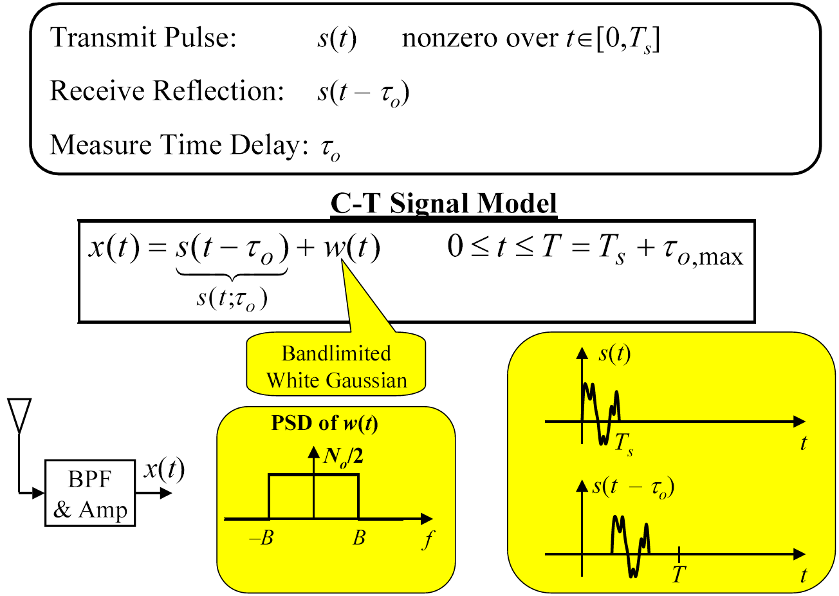
9. Cramer-Rao Lower Bound (CRLB) (25)
Example 1: Range estimation problem

Slide 45
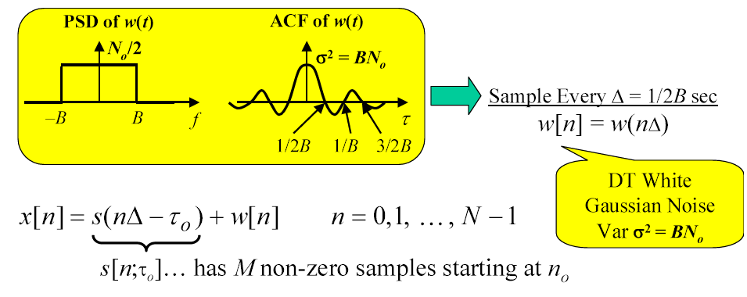
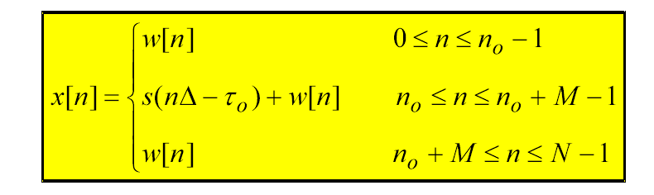
9. Cramer-Rao Lower Bound (CRLB) (26)
Range estimation D-T (Descrete-Time) Signal Model:

Slide 46
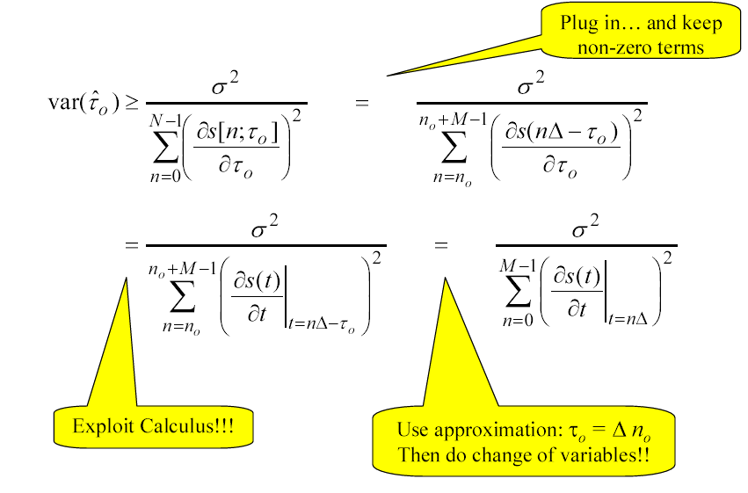
9. Cramer-Rao Lower Bound (CRLB) (27)
Range Estimation CRLB: Applying CRLB result for “signal + WGN:

Slide 47
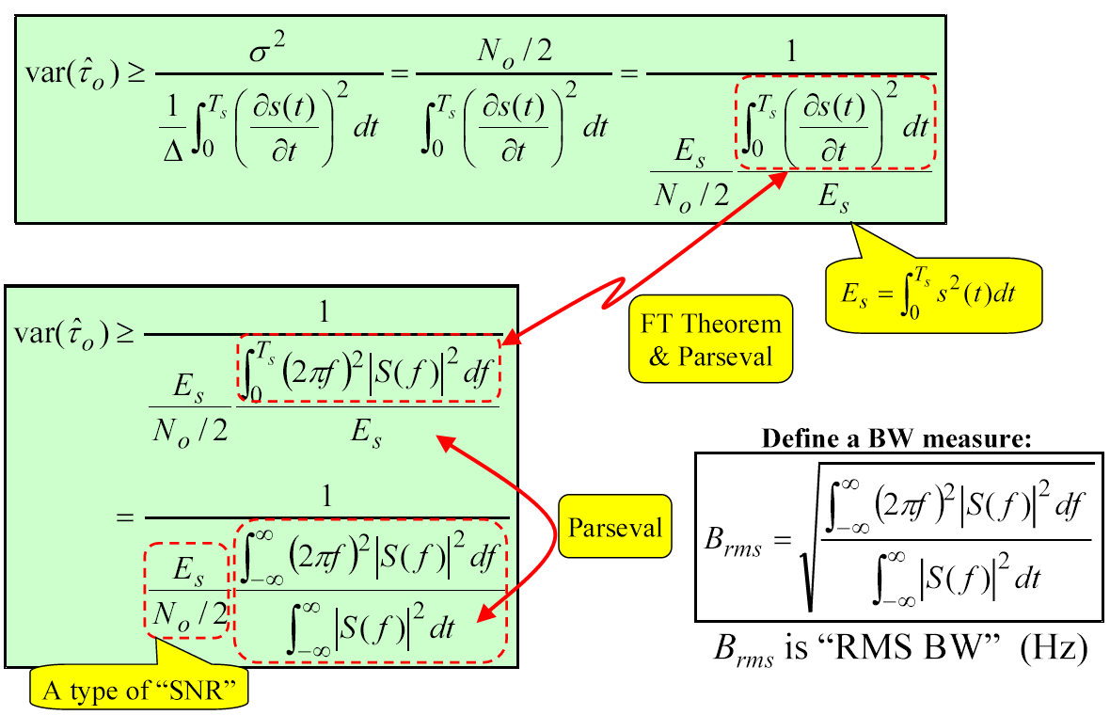
9. Cramer-Rao Lower Bound (CRLB) (28)
Assuming sample spacing is small, approximate sum by integral:

Slide 48
9. Cramer-Rao Lower Bound (CRLB) (29)
Therefore, the CRLB on the delay can be written as
To obtain the CRLB on the range, using R = cτ₀/2, then
CRLB is inversely proportional to:
SNR Measure
RMS BW Measure.
Therefore, the CRLB tells us:
Choose signal with large B_{rms}
Ensure that SNR is large.
Better on nearby/large targets.
Which is better?
– Double transmitted energy?
– Double RMS bandwidth?

Slide 49
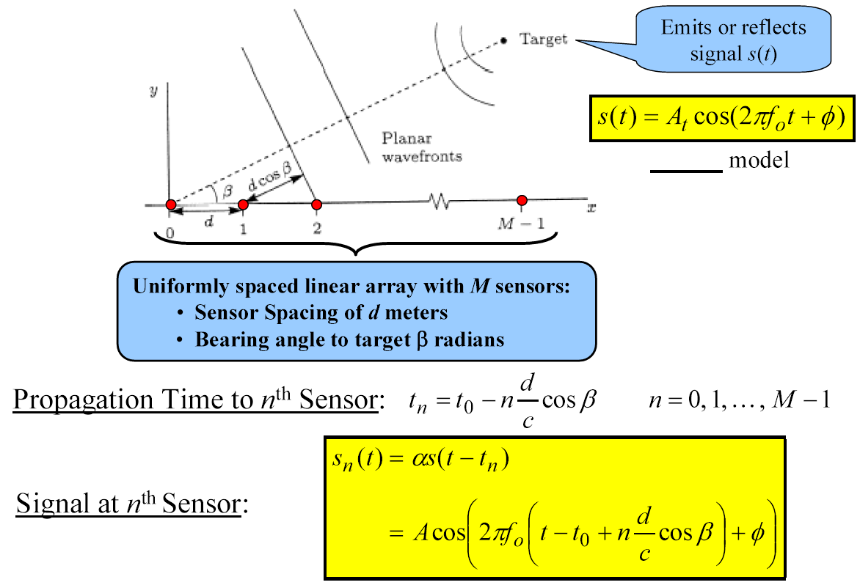
9. Cramer-Rao Lower Bound (CRLB) (30)
Example 2: Bearing estimation CRLB problem

Slide 50
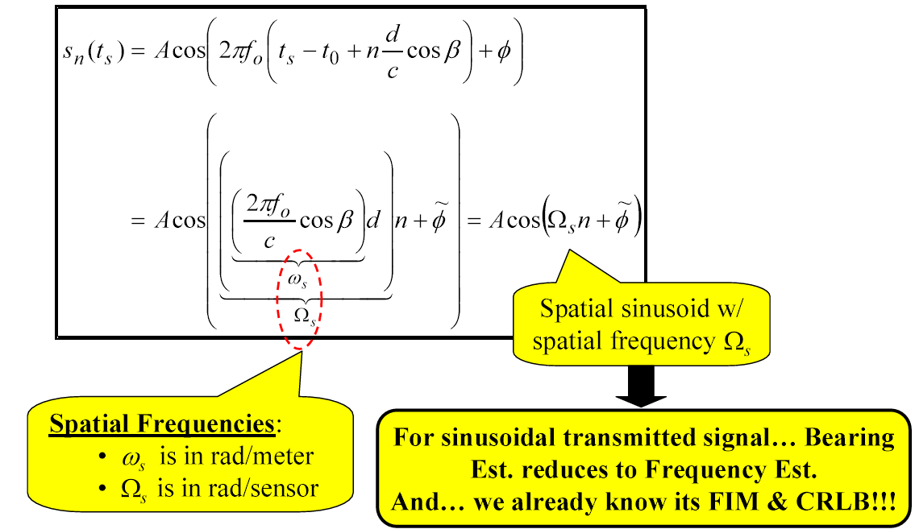
9. Cramer-Rao Lower Bound (CRLB) (31)
Bearing estimation snapshot of sensor signals: Now instead of sampling
each sensor at lots of time instants, we just grab one “snapshot” of all M
sensors at a single instant t_{s}

Slide 51
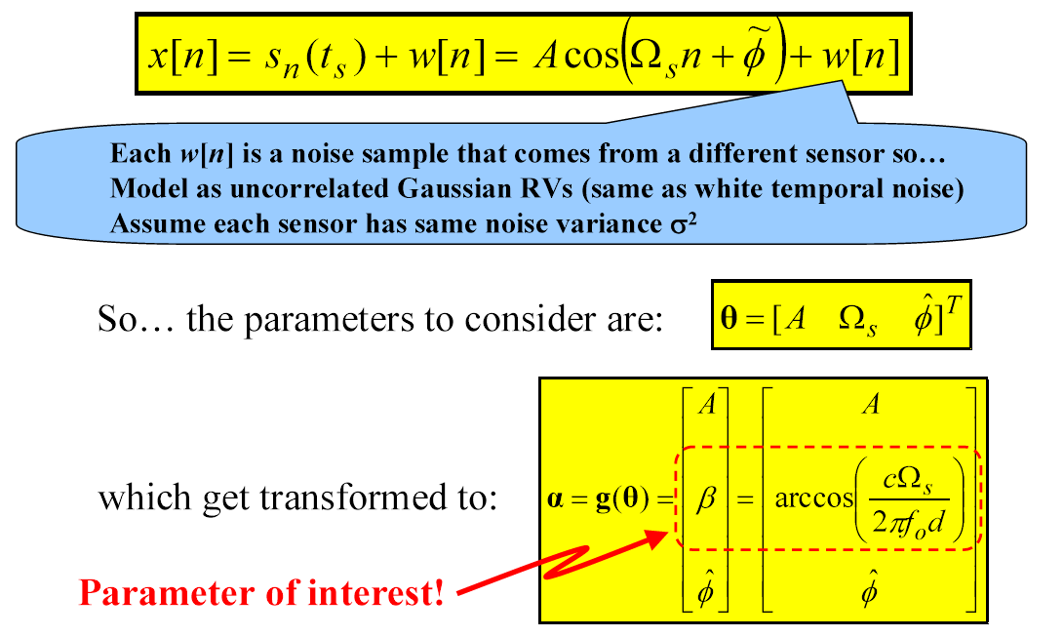
9. Cramer-Rao Lower Bound (CRLB) (32)
Bearing estimation data and parameters: Each sample in the snapshot is corrupted by a noise sample, and these M samples make the data vector:
x = [x[0], x[1], …, x[M-1] ]

Slide 52
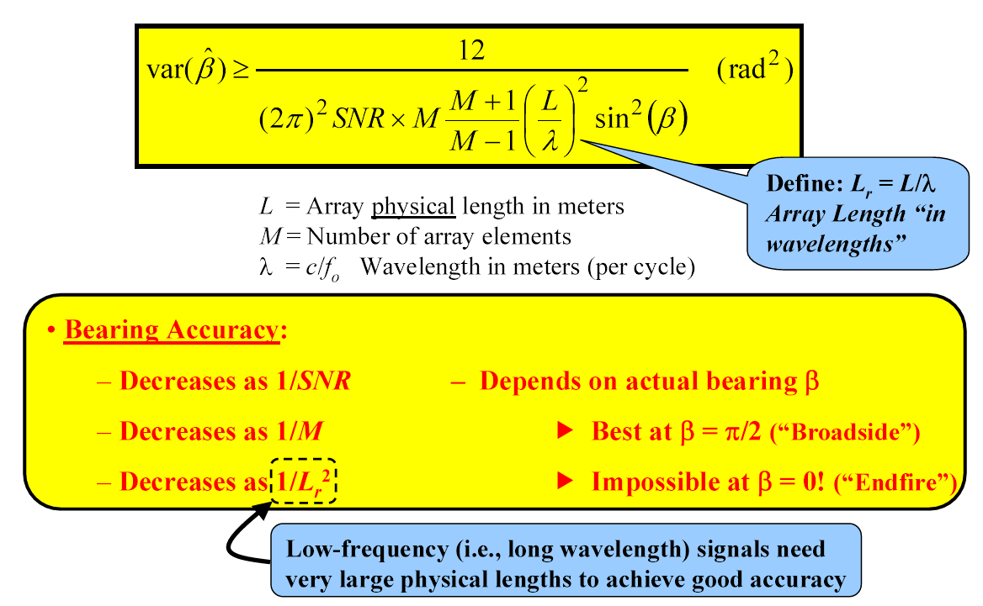
9. Cramer-Rao Lower Bound (CRLB) (33)
Bearing estimation CRLB result: Using the FIM for the sinusoidal parameter proble, together with the transformation of parameters result (see p. 59, [2]):

Slide 53
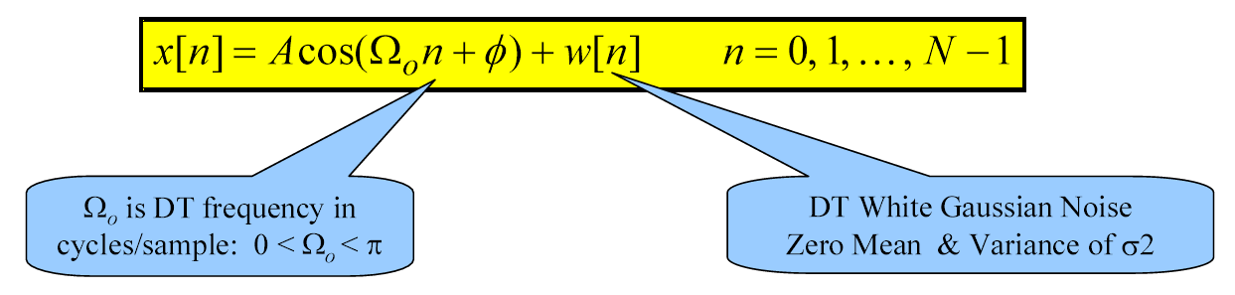
9. Cramer-Rao Lower Bound (CRLB) (34)
Example 3: Sinusoid estimation CRLB problem
Given discrete-time signal samples of a sinusoid in noise, estimate its amplitude, frequency, and phase.
Multiple parameters, so parameter vector:
Recall that SNR of sinusoid in noise is:

Slide 54
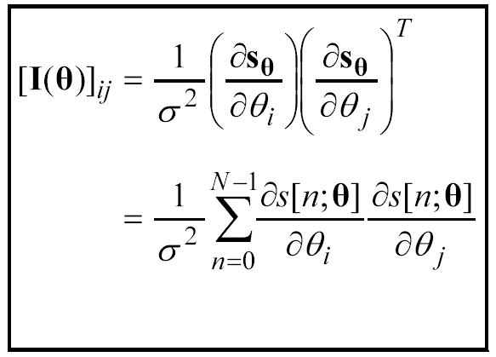
9. Cramer-Rao Lower Bound (CRLB) (35)
Sinusoid estimation CRLB approach:
Find Fisher Info Matrix
• Invert to get CRLB matrix
• Look at diagonal elements to get bounds on parameter variances
Recall: Result for FIM for general Gaussian case specialized to signal in AWGN case:

Slide 55
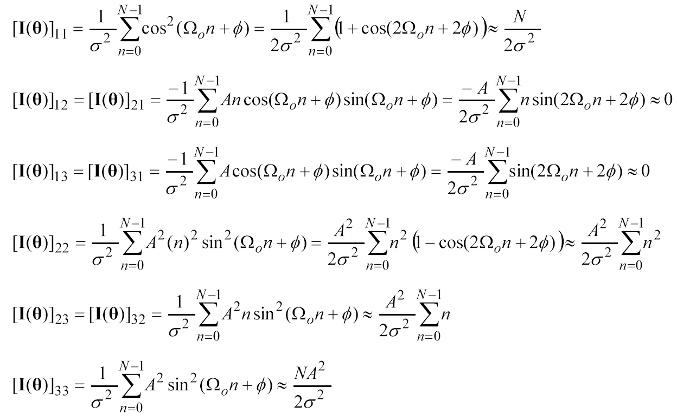
9. Cramer-Rao Lower Bound (CRLB) (36)
Sinusoid estimation Fisher info elements: Taking the partial derivatives and using approximations given in [2] (valid when Ω₀ is not near 0 or π) :

Slide 56
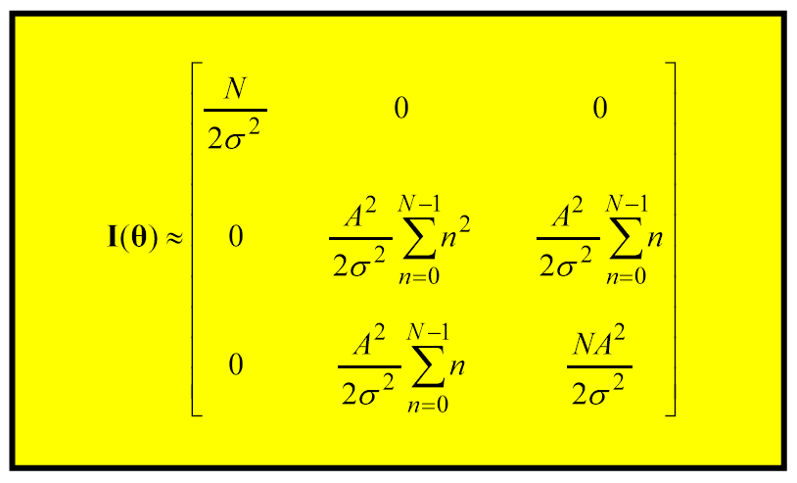
9. Cramer-Rao Lower Bound (CRLB) (37)
Fisher Info Matrix then is:

Slide 57
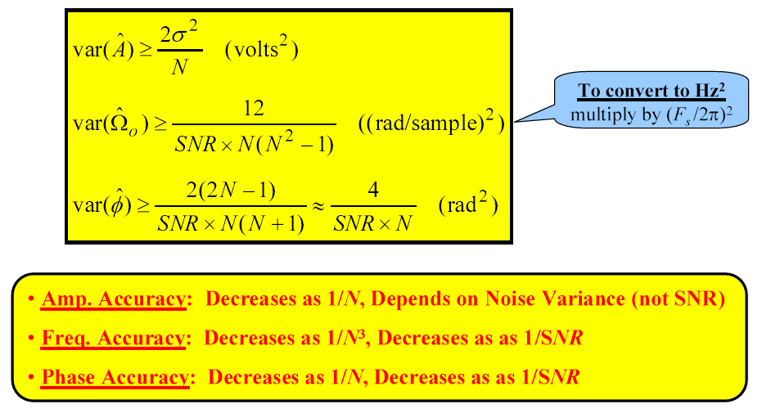
9. Cramer-Rao Lower Bound (CRLB) (38)
Sinusoid estimation CRLBs: Inverting the FIM by hand gives the CRLB matrix and then extracting the diagonal elements gives the three bounds:

Slide 58
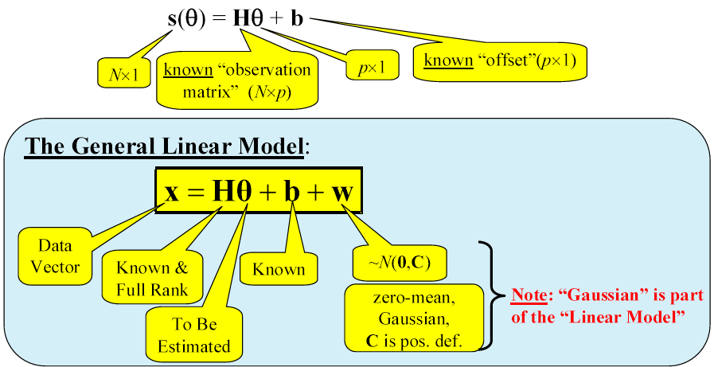
9. Linear Models (1)
General Linear Model
Recall signal + WGN case: x[n] = s[n; θ] + w[n]
In general, it is dependent on θ: x = s(θ) + w
Now we consider a special case: Linear “Observations”:

Slide 59
9. Linear Models (2)
We must assume H is full rank:
If H is not full rank, then for any s: ∃ θ₁, θ₂ such that s = H θ₁ = H θ₂
Importance of the Linear Model:
There are several reasons:
1. Some applications admit this model
2. Nonlinear models can sometimes be linearized
3. Finding optimal estimator is easy (see next slide)

Slide 60
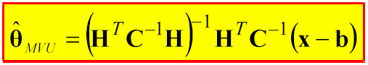
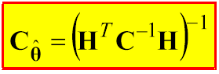
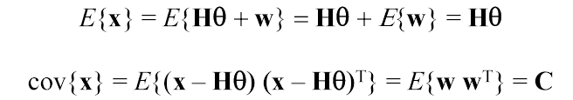
9. Linear Models (3)
MVUE for Linear Model
Theorem: The MVUE for the General Linear Model and its covariance (i.e. its accuracy performance) are given by:
and achieves the CRLB.
Proof: We’ll do this for the b = 0 case but it can easily be done for the more general case.
First we have that x ~ N(Hθ, C) because:

Slide 61
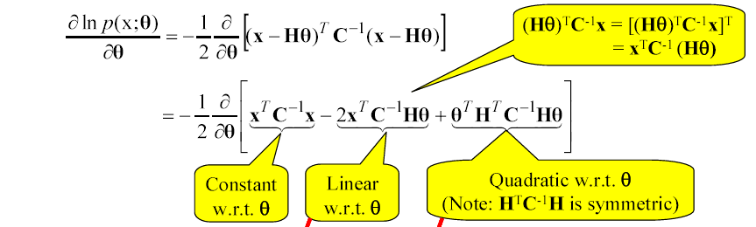
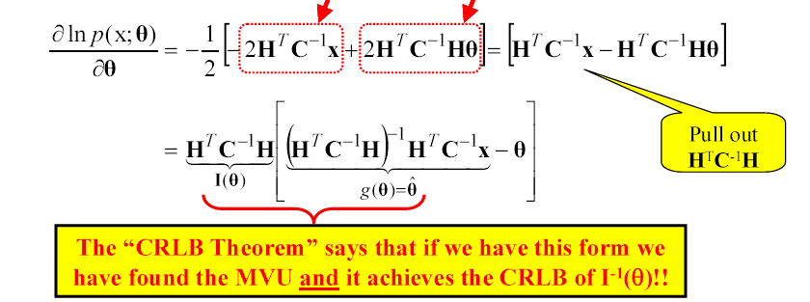
9. Linear Models (4)
Recalling CRLB theorem, look at the partial of LLF:

Slide 62
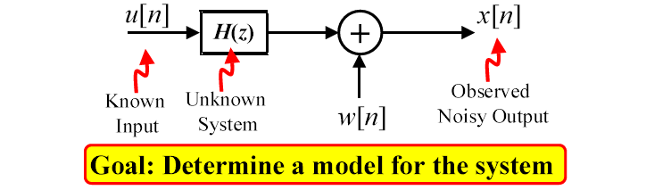
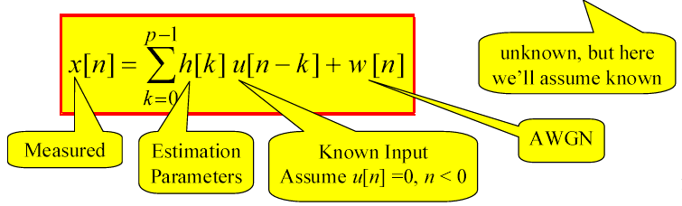
9. Linear Models (5)
Example: System Identification
In many applications: assume that the system is FIR (length p)

Slide 63
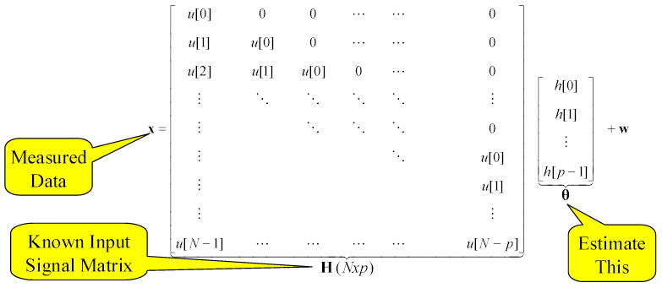
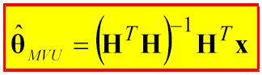
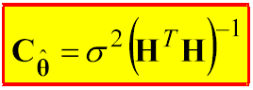
9. Linear Models (6)
Write FIR convolution in matrix form:
The Theorem for the Linear Model says:
and achieves the CRLB.

Slide 64
9. Best Linear Unbiased Estimate (BLUE) (1)
Motivation for BLUE:
Except for Linear Model case, the optimal MVU estimator might:
1. not even exist
2. be difficult or impossible to find
⇒ Resort to a sub-optimal estimate.
BLUE is one such sub-optimal estimate.
Idea for BLUE:
1. Restrict estimate to be linear in data x
2. Restrict estimate to be unbiased
3. Find the best one (i.e. with minimum variance)
Advantage of BLUE: Needs only mean and covariance of PDF.
Disadvantages of BLUE:
1. Sub-optimal (in general)
2. Sometimes totally inappropriate

Slide 65
9. Best Linear Unbiased Estimate (BLUE) (2)
Definition of BLUE (scalar case)
Observed Data: x = [x[0] x[1] . . . x[N – 1] ]^{T}
PDF: p(x; θ) depends on unknown θ
BLUE constrained to be linear in data:
Choose a’s to give:
1. unbiased estimator
2. then minimize variance
Finding The BLUE (scalar case)
1. Constrain to be linear:
2. Constrain to be unbiased:

Slide 66
9. Best Linear Unbiased Estimate (BLUE) (3)
Finding BLUE for scalar linear observations:
Consider scalar-parameter linear observation:
x[n] = θs[n] + w[n] ⇒ E{x[n]} = θs[n]
where s[n]’s are known. Then for the unbiased condition we need:
Now, given that these constraints are met, we need to minimize the variance. Given that C is the covariance matrix of x we have (p. 136, [2]):

Slide 67
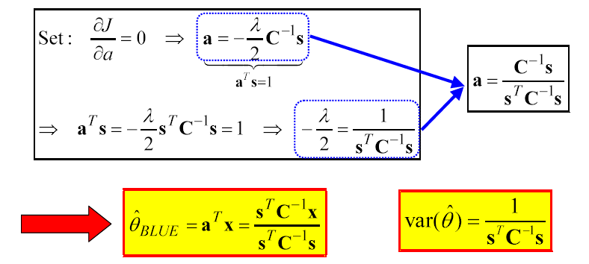
9. Best Linear Unbiased Estimate (BLUE) (4)
Goal: minimize a^{T} Ca subject to a^{T} s = 1 ⇒ Constrained optimization.
From Appendix 6A, pp. 151-152, [2]: Use Lagrangian Multipliers: Minimize
J = a^{T} Ca + λ(a^{T} s – 1)

Slide 68
9. Best Linear Unbiased Estimate (BLUE) (5)
Applicability of BLUE
We just derived the BLUE under the following:
1. Linear observations but with no constraint on the noise PDF.
2. No knowledge of the noise PDF other than its mean and covariance.
3. Noise does not need to be Gaussian.
See Examples 6.1 and 6.2, pp. 137-139, [2].

Slide 69
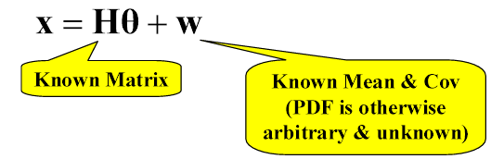
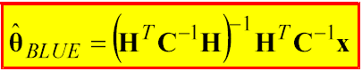
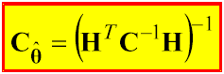

9. Best Linear Unbiased Estimate (BLUE) (6)
Vector Parameter Case: Gauss-Markov Theorem (Linear model without assumption of Gaussian noise)
If data can be modeled as having linear observations in noise:
Then the BLUE is (pp. 139-141, [2]):
and its covariance is:

Slide 70
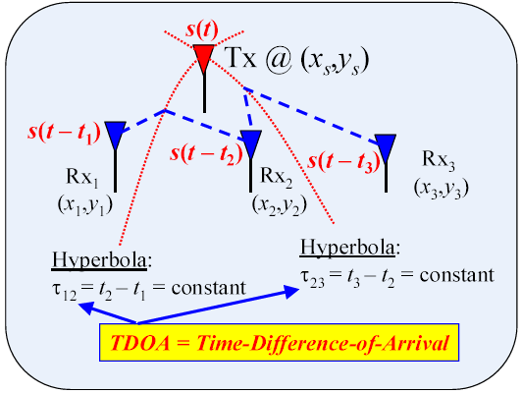
9. Best Linear Unbiased Estimate (BLUE) (7)
Example: TDOA-based emitter location
Assume that the i^{th} Rx can measure its TOA: t_{i}
Then, from the set of TOAs, compute TDOAs
Then, from the set of TDOAs, estimate location (x_{s}, y_{s})

Slide 71
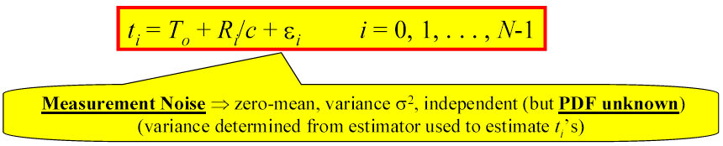
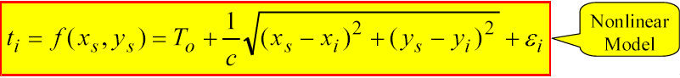
9. Best Linear Unbiased Estimate (BLUE) (8)
TOA measurement model: Assume measurements (with errors) of TOAs at N receivers (only 3 shown above):
t₀ , t₁ , … , t_{N-1}
TOA measurement model:
T_{o} = Time the signal emitted, R_{i} = Range from Tx to Rx_{i}
c = Speed of propagation (for EM: c = 3×10⁸ m/s)
Now, we use then

Slide 72
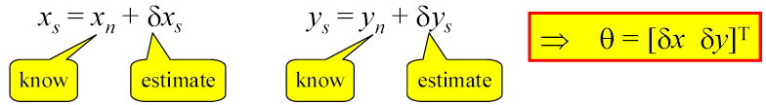
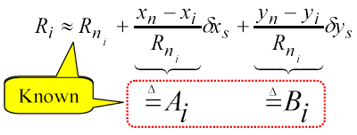
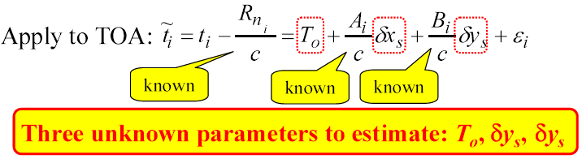
9. Best Linear Unbiased Estimate (BLUE) (9)
Linearization of TOA model: So, we linearize the model so that we can apply BLUE: Assume some rough estimate is available (x_{n}, y_{n})
Now use truncated Taylor series to linearize R_{i} (x_{n}, y_{n}):

Slide 73
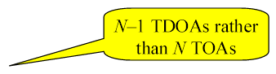
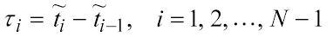
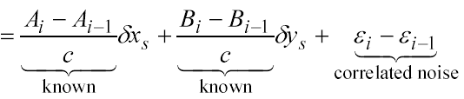
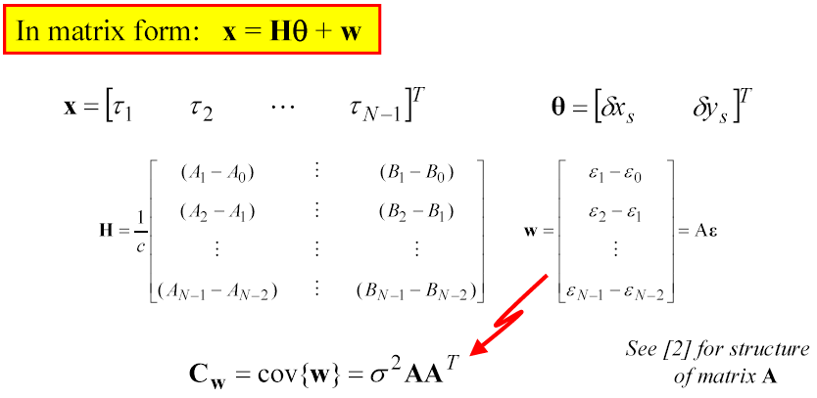
9. Best Linear Unbiased Estimate (BLUE) (10)
Conversion to TDOA model:
TDOAs:

Slide 74
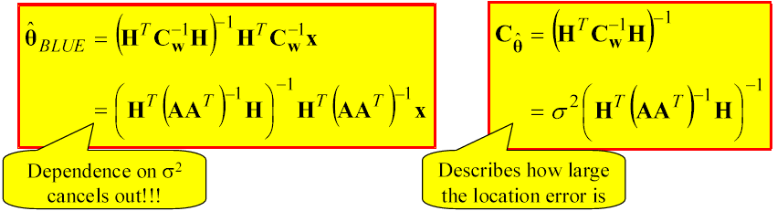
9. Best Linear Unbiased Estimate (BLUE) (11)
Apply BLUE to TDOA linearized model:

Slide 75
9. Maximum Likelihood Estimate (MLE) (1)
Motivation for MLE:
Problems:
1. MVUE often does not exist or can’t be found (See example 7.1 in [2])
2. BLUE may not be applicable (x ≠ Hθ + w)
Solution: If the PDF is known, then MLE can always be used. This makes the MLE one of the most popular practical methods. It will be “optimal” for large enough data size.
Disadvantages:
1. Not optimal for small data size
2. Can be computationally complex - may require numerical methods.

Slide 76

9. Maximum Likelihood Estimate (MLE) (2)
Definition of the MLE:
is the value of θ that maximizes the “Likelihood Function” p(x; θ) for the specific measured data x
Note: Because ln(z) is a monotonically increasing function, maximizes the log likelihood function ln{p(x; θ)}.
General analytical procedure to find the MLE:
1. Find log-likelihood function: ln p(x;θ)
2. Differentiate w.r.t θ and set to 0: ∂ln p(x;θ)/∂θ = 0
3. Solve for θ value that satisfies the equation

Slide 77
9. Maximum Likelihood Estimate (MLE) (3)
Example: DC level in WGN (Example of MLE when MVUE non-existent)

Slide 78
9. Maximum Likelihood Estimate (MLE) (4)
(p. 161)

Slide 79

9. Maximum Likelihood Estimate (MLE) (5)
Properties of the MLE:
The MLE is asymptotically:
1. unbiased
2. efficient (i.e. achieves CRLB)
3. Gaussian PDF
Also, if a truly efficient estimator exists, then the ML procedure finds it !
The asymptotic properties are captured in Theorem 7.1:
If p(x;θ) satisfies some “regularity” conditions, then the MLE is asymptotically distributed according to
where I(θ) = Fisher Information Matrix

Slide 80
9. Maximum Likelihood Estimate (MLE) (6)
Size of N to achieve asymptotic:
This Theorem only states what happens asymptotically. When N is small there is no guarantee how the MLE behaves.
How large must N be to achieve the asymptotic properties?
⇒ In practice: use “Monte Carlo Simulations” (see Appendix 7, [2]) to answer this.

Slide 81

9. Maximum Likelihood Estimate (MLE) (7)
Monte Carlo Simulations: A methodology for doing computer simulations to evaluate performance of any estimation method (not only for the MLE).
Illustrate Monte Carlo Simulation for deterministic signal s[n; θ] in AWGN:
Data Collection:

Slide 82

9. Maximum Likelihood Estimate (MLE) (8)
Statistical Evaluation:
(if desired)

Slide 83
9. Maximum Likelihood Estimate (MLE) (9)
Now explore (via plots): How Bias, RMS, and VAR vary with
θ value, SNR value, N value, etc.
Is b ≈ 0 ?
Is RMS ≈ (CRLB)½ ?

Slide 84


9. Maximum Likelihood Estimate (MLE) (10)
Phase estimation for a sinusoid:
Signal model: x[n] = Acos(2πf_{o} n + φ) + w[n], n = 0, 1,…, N-1
A and f_{o} known, φ unknown.

Slide 85

9. Maximum Likelihood Estimate (MLE) (11)

Slide 86

9. Maximum Likelihood Estimate (MLE) (12)
Monte Carlo results for ML phase estimation: See figures 7.3 & 7.4 in [2].

Slide 87
9. MLE Examples (1)
We’ll now apply the MLE theory to several examples of practical signal processing problems. These are the same examples for the CRLB.
1. Range estimation
–sonar, radar, robotics, emitter location
2. Sinusoidal parameter estimation (amplitude, frequency, phase)
–sonar, radar, communication receivers (recall DSB example), etc.
3. Bearing estimation
–sonar, radar, emitter location.
4. Autoregressive parameter estimation
–speech processing, econometrics.

Slide 88

9. MLE Examples (2)
Example 1: Range estimation

Slide 89

9. MLE Examples (3)
Range estimation D-T signal model:

Slide 90

9. MLE Examples (4)
Range estimation likelihood function:

Slide 91

9. MLE Examples (5)

Slide 92

9. MLE Examples (6)
Think of this as an inner product for each m.
Compare data x[n] to all possible delays of signal s[n]
pick n_{o} to make them most similar.

Slide 93

9. MLE Examples (7)
Example 2: Sinusoid parameter estimation
Given D-T signal samples of a sinusoid in noise ⇒ Estimate its amplitude, frequency, and phase.

Slide 94




9. MLE Examples (8)
To make things easier, define an equivalent parameter set:
Then
Define
and an N × 2 matrix.
Then
This looks like the linear model case, except for Ω_{o} dependence of
H(Ω_{o})

Slide 95



9. MLE Examples (9)
Thus, for any fixed Ω_{o} value, the optimal α estimate is
Then plug that into

Slide 96




9. MLE Examples (10)
Sinusoid parameter estimation MLE procedure:
Step 1: Minimize
over Ω_{o} to find:
Step 2: Use result of Step 1 to get
Step 3: Convert Step 2 result by solving

Slide 97



9. MLE Examples (11)
Approximation:
First we look at a specific structure:
If Ω_{o} is not near 0 or π, then approximately

Slide 98


9. MLE Examples (12)
Then, Step 1 becomes:
and Steps 2 & 3 become:

Slide 99

9. MLE Examples (13)
The processing is implemented as follows:
Given the data: x[n], n= 0, 1, 2, … , N-1
1. Compute the DFT X[m], m= 0, 1, 2, … , M-1 of the data
Zero-pad to length M= 4N to ensure dense grid of frequency points.
Use the FFT algorithm for computational efficiency.
2. Find location of peak
Use quadratic interpolation of |X[m]|
3. Find height at peak
Use quadratic interpolation of |X[m]|
4. Find angle at peak
Use linear interpolation of ∠X[m]

Slide 100


9. MLE Examples (14)
Example 3: Bearing estimation MLE
Grab one snapshot of all M sensors at a single instant t_{s}:
Solution: Same as Sinusoidal estimation (example 2). So, compute DFT and find location of peak.

Slide 101


9. Spectral Estimation (1)
Definition of PSD (Power Spectral Density)
Given a WSS discrete-time random process x[n], the PSD is defined by:
Recall the Wiener-Khinchine theorem:
(1)
(2)

Slide 102
9. Spectral Estimation (2)
Problem of PSD estimation:
Both (1) and (2) involve ensemble averaging but in practice we get only one realization from the ensemble.
Both (1) and (2) use a Fourier transform of infinite length but in practice we get only a finite number of samples.
(Note: a finite number of samples allows only a finite number of autocorrelation function - ACF values)
(1) & (2) motivate two approaches to PSD estimation:
1. Compute the DFT of the signal and then do some form of averaging.
2. Compute and estimate of the ACF using some form of averaging and then compute the DFT.
Both of them are called classical non-parametric approaches –they strive to do the best with the available data without making any assumptions other than that the underlying process is WSS.

Slide 103
9. Spectral Estimation (3)
Modern parametric approach:
There is a so-called modern approach to PSD estimation that tries to deal with the issue of having only a finite number of samples:
Assume a recursive model for the ACF.
Allows recursive extension of ACF using the known values.
Example model:
We’ll see that for this approach all we’ll need to do is estimate the model parameters {a_{i}} and then use them to get an estimate of the PSD. Thus, this approach is called parametric.

Slide 104

9. Spectral Estimation (4)
Review of statistics
What are we doing in PSD estimation?
Given: Finite number of samples from one realization.
Get: Something that “resembles” the PSD of the process.
Each PSD estimate is a realization of a random process.
Each signal
realization
gives a different
PSD estimate
realization

Slide 105


9. Spectral Estimation (5)
Thus, must view PSD estimate as a random process.
Need to characterize its mean and variance:
Want mean of PSD estimate = true PSD
Want variance of PSD estimate = small
To make things easier to discuss, we use a slightly different estimation problem to illustrate the ideas, consider the process:
Given a finite set of data samples x[0],…, x[N-1], estimate A.
Reasonable estimate (sample mean) is:
For each realization of x[n] we get a different value for the estimate of A.

Slide 106




9. Spectral Estimation (6)
We want two things for the estimate:
1. We want our estimate to be “correct on average”:
If this is true, we say the estimate is unbiased.
If it is not true then we say the estimate is biased.
If it is not true, but
we say that the estimate is asymptotically unbiased.
2. We want small fluctuations from estimate to estimate:
Also, we’d like

Slide 107


9. Spectral Estimation (7)
Can capture both mean and variance of an estimate by using Mean-Square-Error (MSE):
Usual goal of estimation: Minimize MSE
Minimize Bias
Minimize Variance.
For PSD Estimation want:

Slide 108
Non-Parametric Spectral Estimation
Periodogram
Windowed Periodogram
Averaged Periodogram
Windowed & Averaged Periodogram
Blackman-Tukey Method
Minimum Variance Method

Slide 109

9. Family of Non-Parametric Methods

Slide 110

9. Family of Classical Methods

Slide 111


9. Periodogram (1)
Periodogram –Definition
Based on:
In practice, we have one set of finite-duration data. Two practical problems:
1. Can’t do the expected value
2. Can’t do the limit.
The periodogram is a method that ignores them both:
In practice, we compute this using the DFT (possibly using zero-padding) –which computes the DTFT at discrete frequency points (DFT bins).

Slide 112


9. Periodogram (2)
Periodogram –Computation
In practice, we compute this using the DFT (FFT) (usually using zero-padding) –which computes the DTFT at discrete frequency points (DFT bins):

Slide 113


9. Periodogram (3)
Periodogram –viewed as Filter Bank
Although we always implement the periodogram using the DFT, it is helpful to interpret it as a filter bank.
Define the impulse response of an FIR filter as:
Frequency Response of this filter is:

Slide 114



9. Periodogram (4)
Now the output of the i^{th} filter is:
Now one estimate of the power at the output of this filter is: for any value of n. Choosing n= N-1 gives the periodogram:

Slide 115

9. Periodogram (5)
Periodogram –Performance
For a good PSD estimate we’d like to have (at the very least):
Actually, we would prefer it to be unbiased even for finite N.
Does the periodogram have these characteristics?
: Asymptotic unbiased

Slide 116
9. Periodogram (6)
Property #1: The periodogram is biased.
Property #2: But, the periodogram is asymptotically unbiased.

Slide 117

9. Periodogram (7)
Proof: Taking the expected value of the periodogram gives
Sum on diagonals
r_{x}[n-m] is constant on
each diagonal
Bartlett (Triangle)
window

Slide 118

9. Periodogram (8)
This shows that the periodogram is biased. The bias comes from the smoothing effect of Bartlett window.
(Smoothing also reduces the resolution of sharp spectral features)
But, as N→∞, the Bartlett kernel tends to a delta function in the frequency domain, or –equivalently –in the time domain the Bartlett window tends 1:
Thus, the periodogram is asymptotically unbiased.

Slide 119


9. Periodogram (9)
Property #3: The variance of the periodogram does not (in general) tend to zero as N→∞.
Proof: Difficult to prove for general case, so this is proved under the assumption: complex-valued white Gaussian process with zero mean and variance σ².
Under this assumption, the true PSD and ACF are:
The variance of the periodogram is what we want to analyze and is given by:
Bias term

Slide 120


9. Periodogram (10)
So from our previous analysis of bias (and our assumptions on the process) we know that the second term is:
So the variance of periodogram is now:

Slide 121


9. Periodogram (11)
As a means of looking at this first term we consider:

Slide 122

9. Periodogram (12)
Since we assumed the process is Gaussian we can use a standard result for complex joinly Gaussian RVs:
Using this result together with the assumption of whiteness:

Slide 123

9. Periodogram (13)
Therefore,

Slide 124



9. Periodogram (14)
Now the Fourier transform of the Bartlett window is:
So using it in the above result gives:

Slide 125



9. Periodogram (15)
To find the first term in the variance expression of interest, we must set ω = ω₁= ω₂ in the above expression to get:
Now using this in the expression for variance gives:
which does not go to zero as N→∞

Slide 126

9. Periodogram (16)
Property #4: Increasing N leads to rapidly fluctuating periodograms (even where the true PSD is smooth).
Proof: Use the previous results, the covariance of the periodogram is given by
Covariance is a measure of how correlated two RVs are. Thus, cov(X,Y) = 0 indicates that there is a high probability that X & Y will be very unalike.

Slide 127
9. Periodogram (17)
Now, the equation above indicates there are (ω₁, ω₂) pairs for which the covariance of the periodogram is zero.
⇒ Periodogram fluctuates rapidly from frequency-to-frequency.

Slide 128
9. Periodogram (18)
Example:
Periodogram of a sum of sinusoids in white Gaussian noise. The sinusoids are with frequencies of 0.1f_{s}, 0.25f_{s}, 0.375f_{s} and 0.4f_{s}, and with amplitudes of 5, 1, 5 and 5, respectively. The f_{s} is sampling frequency. The second sinusoid is with smaller amplitude than others while the third sinusoid is very close to the fourth sinusoid. Number of signal samples is 40, DFT size is 2048. The white Gaussian noise is with variance of 1.

Slide 129
9. Periodogram (19)

Slide 130
9. Periodogram (20)

Slide 131
9. Practical Classical Methods (1)
Main problems of the periodogram
Biased estimate
Variance does not decrease with increasing N
Rapid fluctuations
All of these arise due to the fact that the periodogram ignores:
The expected value – (It includes no averaging)
The limit operation – (It applies a rectangular window)
in the PSD definition.
Several classical methods for partially fixing these have been proposed.

Slide 132

9. Practical Classical Methods (2)
Modifications based on periodogram view
Recall: Family of classical methods:

Slide 133


9. Practical Classical Methods (3)
Modified periodogram –windowed
The modified periodogram uses a non-rectangular window and therefore has to be scaled to account for the loss of power due to the window. This scaling is required to make the modified periodogram asymptotically unbiased:
where the scaling factor is
Note: U = 1 for a rectangular window.
As in the ordinary periodogram, the DFT/FFT is used for computation and zero-padding is usually used.

Slide 134
9. Practical Classical Methods (4)
The modified periodogram:
Has reduced bias but is still biased.
Is asymptotically unbiased.
Has variance that roughly equals that of the periodogram.

Slide 135
9. Practical Classical Methods (5)
Example:
Modified (windowed) periodogram using Hamming window. The sinusoids in white Gaussian noise are with frequencies of 0.1f_{s}, 0.25f_{s}, 0.375f_{s} and 0.4f_{s}, and with amplitudes of 5, 1, 5 and 5, respectively. The f_{s} is sampling frequency. The second sinusoid is with smaller amplitude than others while the third sinusoid is very close to the fourth sinusoid. Number of signal samples is 40, DFT size is 2048. The white Gaussian noise is with variance of 1.

Slide 136
9. Practical Classical Methods (6)

Slide 137
9. Practical Classical Methods (7)
Bartlett’s method: Averaged periodogram
One of the main flaws in the periodogram is the lack of averaging.
This lack of averaging is what leads to the non-decreasing variance as well as the rapid fluctuations of the periodogram.
Now, in practice we have only one realization.
We hope that the process is ergodic (A process is ergodic if time averaging of any realization is equivalent to ensemble averaging).

Slide 138


9. Practical Classical Methods (8)
Bartlett’s method –definition
The signal data of length N is chopped into K non-overlapping blocks of length L (the length L is a design choice); N = KL:
Block definition:

Slide 139



9. Practical Classical Methods (9)
Variance improvement
The intent of averaging here is to improve the variance. To see how lets first just look at a simple related example:
Let X_{i}, i= 0, 1, …, K-1 be a sequence of independent, identically distributed RVs each having zero-mean and variance σ². What is the variance of the data analysis average of them?

Slide 140


9. Practical Classical Methods (10)
Welch’s method: Averaged windowed periodogram
We’ve seen:
Windowing helps the bias
Averaging helps the variance
Welch: Do both and use overlapped blocks.
Block definition:
The amount of overlap is L–D points:
D= L: No overlap
D= L/2:50% overlap (most common)
D= 3L/4:25% overlap
Implement using
DFT/FFT and
zero-padding

Slide 141


9. Practical Classical Methods (11)
Variance has been shown to be for 50% overlap:
Compared to Bartlett’s method (no overlap) for the same N and L:
almost a 50% reduction.

Slide 142
9. Practical Classical Methods (12)
Windowing is useful for signals containing sinusoids + noise
Sidelobes of a stronger sinusoid may mask the main lobe of a
nearby weak sinusoid.
We multiply x[n] by window w[n] before computing periodogram
Weaker sinusoid becomes more visible, but main lobe of each sinusoid broadens: two close peaks may merge into one.

Slide 143
9. Practical Classical Methods (13)

Slide 144

9. Practical Classical Methods (14)
Commonly used windows:

Slide 145

9. Practical Classical Methods (15)
Modifications based on ACF view: Blackman-Tukey method
Periodogram’s biggest problem is a variance that does not decrease with increasing N.
The methods we’ve seen dealt with this by averaging.
There is another way to combat this. To see how, we need to write the periodogram differently –motivated by the Wiener-Khinchine theorem:

Slide 146

9. Practical Classical Methods (16)
The periodogram can be written as:

Slide 147


9. Practical Classical Methods (17)
Thus, the periodogram can be written as:
i.e, as a DTFT of an estimated ACF given by
It is the poor quality of this ACF estimate that gives rise to the periodogram’s poor quality.

Slide 148

9. Practical Classical Methods (18)
Example of ACF estimation:

Slide 149

9. Practical Classical Methods (19)
Blackman-Tukey method –defined:
For the biased ACF estimate, the estimated ACF lags for large |k| values are unreliable.
De-emphasize these unreliable lags by applying a window to the biased ACF estimate. This is the Blackman-Tukey method:
with M < N – 1.
Since windows taper off to zero at their edges this causes the poor-quality estimates at large |k| values to have less impact on the PSD estimate.

Slide 150


9. Practical Classical Methods (20)
In practice we compute this using the DFT(FFT) (usually using zero-padding) –which computes the DTFT at discrete frequency points (DFT bins):
It is useful to explore a frequency domain interpretation of it. By using the multiplication-convolution theorem for DTFT we have:
The BT estimate is a smoothed version of the periodogram.
( Product in Time Domain) ⇔
(Convolution in Frequency Domain)

Slide 151

9. Practical Classical Methods (21)
BT performance: Bias:

Slide 152


9. Practical Classical Methods (22)
BT performance: Variance:

Slide 153



9. Practical Classical Methods (23)
Now, further approximation must be done do get a meaningful result. If N is large enough, the sin-over-sin kernel will be enough like a delta function (with area 2π/N) to treat it approximately as one:
Now, further approximation: assume that the true PSD is fairly constant over any interval of width = to mainlobe of W(ω):
Paserval theorem

Slide 154

9. Practical Classical Methods (24)
Recommended: M < N/5
Basic Tradeoff between Bias and Variance:
Need large M to get small bias
– In order to get narrow mainlobe and low sidelobes.
• Need M << N to get low variance
– In order to reduce the bracketed term in variance equation.

Slide 155

9. Practical Classical Methods (25)
Performance measures
Variability (small v is desirable):
Resolution: One of the important measures of goodness for spectral analysis is resolution –the ability to see two closely-spaced sinusoids.
The width of the mainlobe of the window’s kernel impacts this ability. There are many ways to measure resolution, one way is:
Small Δω is desirable. Two things impact mainlobe width:
1. Window length: Δω ↓ as Length ↑
2. Window shape (e.g. Hanning, Hamming, etc.)
There is a tradeoff between Δω and sidelobe level.

Slide 156

9. Practical Classical Methods (26)
Overall Figure of Merit
It is helpful to have a single measure by which to compare methods. This is done using the following Figure of Merit:
Since v and Δω are both required to be as small as possible, we also want the figure of merit to be as small as possible.

Slide 157

9. Practical Classical Methods (27)
Performance comparison of classical methods

Slide 158
9. Practical Classical Methods (28)
Complexity comparison of classical methods
Welch and BT methods are the most commonly used ones. But counting the number of complex multiplies needed for each one, it is easy to see that: Welch requires a bit more computation then BT.
But, for BT, none of the ACF lags can be estimated until ALL of the data is obtained –therefore no computing can be done until all the data is obtained. For Welch, DFT’s can be started as soon as each block arrives.
Welch might have a real-time advantage.

Slide 159

9. Minimum Variance Method (MVSE) (1)
Family of Non-Parametric Methods

Slide 160
9. Minimum Variance Method (2)
The Minimum Variance Spectral Estimation (MVSE) method has two other names:
Maximum Likelihood Method (MLM)
Capon’s Method
Note: The names MVSE and MLM are actually misnomers –this method:
does NOT minimize the variance of the estimate
does NOT maximize the “likelihood function”

Slide 161

9. Minimum Variance Method (3)
Recall: Filter bank view of periodogram
The problem is leakage from nearby frequencies:

Slide 162

9. Minimum Variance Method (4)
Goal for MVSE Method
Figure out a way to design each filter bank channel response to minimize the leakage –this is thus a data-dependent design.
Collect Data ⇒ Design filters for filter bank
Want to design filters to minimize the sidelobes while keeping the mainlobe height at 1:
Design goals:
1. Want H_{i}(ω_{i}) = 1 to let through the desired S_{x}(ω_{i})
2. Minimize total output power in the filter:
This is equivalent to minimizing the sidelobe contribution even though the integral includes the desired ω_{i}

Slide 163


9. Minimum Variance Method (5)
Useable form for ρ
The frequency response of filter h_{i}[n] is:
Using this in the expression for ρ gives:
p = Filter length, p < N
Recognize as vector-matrix-vector multiplication, R_{x}: correlation matrix

Slide 164




9. Minimum Variance Method (6)
For each i, minimize this:
Under this constraint:
where
Most common way to do constrained optimization is using the Lagrange Multiplier method:
Find h_{i} and λ to minimize J, in general set:
But often an easier way is to do these two steps:
1. Do the partial w.r.t. h_{i} and solve for h_{i}
2.Then choose λ to ensure solution meets the constraint

Slide 165


9. Minimum Variance Method (7)
Gradient:
If g(x) is a scalar-valued function of a real-valued vector x, then the gradient of g(x) is defined as:
Gradient here is nothing more than: the vector whose elements are the partials w.r.t. each element of x.
(Note: There are similar definitions when g(x) is vector-valued.)
Example:

Slide 166




9. Minimum Variance Method (8)
Step 1: For our scalar-valued function J, we get:
Solve this for h_{i,o}:
Step 2: Choose λ to make this solution satisfy constraint:
Now use this λ in optimal h_{i,o}:
This gives the optimal filter for estimating the power at the frequency ω_{i}

Slide 167


9. Minimum Variance Method (9)
In principle–we need to solve h_{i,o} for each frequency ω_{i} at which we wish to get a PSD estimate. Then we would compute the output power at each filter and that would be our PSD estimate (based on an equation for the output power: ρ_{i})
The estimate of the power at ω_{i} is nothing more than the minimized value of ρ_{i}:
Thus, the estimated power at frequency ω_{i} is:

Slide 168

9. Minimum Variance Method (10)
To get the power spectral density (PSD) we need to divide by the filter’s bandwidth –for a filter of length p the bandwidth is approximately 1/p so our MVSE PSD estimate is:
This estimate requires the ACF in matrix form. So, we need an estimate of the ACF in matrix form.

Slide 169


9. Minimum Variance Method (11)
Estimating ACF in matrix form:
where

Slide 170
9. Minimum Variance Method (12)
MVSE –Comments:
Implementation of MVSE:
Generally done directly on the data matrix X for efficiency.
Even with that, it is more complex than classical methods.
Performance of MVSE:
Provides better resolution than classical methods.
Mostly used when spiky spectra are expected
(Although, the AR methods are usually better in that case)
If required resolution can be met with classical methods, then use them. If not –consider either MVSE or Parametric methods.

Slide 171
Parametric Spectral Estimation

Slide 172
9. Parametric Spectral Estimation (1)
Time series models = Parametric models
Time series = Discrete-time random signal

Slide 173


9. Parametric Spectral Estimation (2)
Motivation for time series models
If the input ε[n] is white with power σ² then:
Then the shape of output PSD is completely set by H(ω).
Thus, under this model, knowing the LTI system’s transfer function (or frequency response) tells everything about the PSD.

Slide 174

9. Parametric Spectral Estimation (3)
The transfer function of an LTI system is completely determined by a set of parameters {b_{k}} and {a_{k}}:
If we can assure that the random processes can be modeled as the output of a LTI system driven by white noise, then
Estimating Parameters = Estimating PSD

Slide 175



9. Parametric Spectral Estimation (4)
Parametric PSD models
The most general parametric PSD model is then:
Model parameters:
The output of the LTI system gives a time-domain model for the process:

Slide 176
9. Parametric Spectral Estimation (5)
There are three special cases that are considered for these models:
Autoregressive (AR)
Moving Average (MA)
Autoregressive Moving Average (ARMA)

Slide 177


9. Parametric Spectral Estimation (6)
Autoregressive (AR) PSD models
If the LTI system’s model is constrained to have only poles, then:
Order of the model is p: called AR(p) model
Poles give rise to PSD spikes.
Output depends
regressively on itself

Slide 178


9. Parametric Spectral Estimation (7)
Moving Average (MA) PSD models
If the LTI system’s model is constrained to have only zeros, then:
Order of the model is q: called MA(q) model.
Zeros give rise to PSD nulls.
Output is an average of values inside a moving window

Slide 179


9. Parametric Spectral Estimation (8)
Autoregressive Moving Average (ARMA)
If the LTI system’s model is allowed to have Poles & Zeros, then:
Order of the model is p,q : called ARMA(p,q) model
Poles & Zeros give rise to PSD spikes and nulls.

Slide 180


9. Parametric Spectral Estimation (9)
ACF model of a process
So far we’ve seen relationships between:
PSD model
Time-domain model
These models impart a corresponding model to the ACF:
Let the process obey an ARMA(p,q) model:
To get ACF: multiply both sides of this by x[n-k] and take E{}:

Slide 181


9. Parametric Spectral Estimation (10)
To evaluate this –write x[n] as output of filter with input ε[n]:
We have assumed a causal filter for a model:

Slide 182

9. Parametric Spectral Estimation (11)
Using this result gives the Yule-Walker equations for ARMA:
These equations are the key to estimating the model parameters.
We now look at simplifications of these for the AR and MA cases.
(ARMA)

Slide 183


9. Parametric Spectral Estimation (12)
ACF model for an AR process
Specializing to the AR case, we set q= 0 and get:
Now, we see that
Initial value theorem
for Z-Transform

Slide 184

9. Parametric Spectral Estimation (13)
Yule-Walker equations (AR):
If we look at k = 0, 1, …p for these AR Yule-Walker equations, we get p+1 simultaneous equations that can be solved for the p+1 model parameters of {a_{i}}_{i=1,…,p} and σ²:
(AR)

Slide 185

9. Parametric Spectral Estimation (14)
If we know the p×p autocorrelation matrix, then we can solve these equations for the model parameters.
Yule-Walker Equations (AR)

Slide 186



9. Parametric Spectral Estimation (15)
ACF model for an MA process
Specializing to the MA case, we set p = 0 and get:
But, for the MA case the system is a FIR filter and we have
Yule-Walker equations (MA):
(MA)

Slide 187
9. Parametric Spectral Estimation (16)
Parametric PSD estimation
As mentioned above, the idea here is to find a good estimate of the model parameters and then use those to get an estimate of the PSD. The basic idea holds regardless if it is ARMA, AR, or MA. We consider only the AR case.
Here is the general AR method: Given data {x[n], 0 ≤ n ≤ N-1}
Estimate the p×p autocorrelation matrix from the data:
Solve the AR Yule-Walker equations for the AR model:

Slide 188


9. Parametric Spectral Estimation (17)
3. Compute the PSD estimate from the model

Slide 189


9. Parametric Spectral Estimation (18)
Two common methods (but there are many others):
Autocorrelation method
Estimate the ACF using:
Covariance method
Estimate using:

Slide 190

9. Parametric Spectral Estimation (19)
Solve using

Slide 191

9. Parametric Spectral Estimation (20)
Least Squares method & linear prediction
There is another method that is often used that comes at the problem from a little different direction.
Recall: The above idea was based on the Yule-Walker equations, which are in terms of the ACF (which is unknown in practice). Thus we need to estimate the ACF to use this view.
Least Squares provides a different way to estimate the AR parameters.
Recall: The output of an AR model is given by

Slide 192


9. Parametric Spectral Estimation (21)
If we re-arrange this output equation we get:
There are lots of applications where linear prediction is used: Data compression, target tracking, noise cancellation etc.
Goal: Find a set of prediction coefficients {a_{k}} such that the sum of squares (least squares) of the prediction error is minimized.

Slide 193



9. Parametric Spectral Estimation (22)
To choose the {a_{k}} to minimize V we differentiate and set = 0
Now we use:

Slide 194




9. Parametric Spectral Estimation (23)
So to solve the LS linear prediction problem we need:
Define:
1. Matrix Γ with elements λ_{lk}
2. Vector λ with elements λ_{l0}
3. Vector a with elements a₁,…, a_{p}
where
Then (*) can be written as (exploiting that a₀= 1):
or
(*)

Slide 195
Modern Spectral Estimation High Resolution Spectral Estimation Based on Subspace Eigen-Analysis
Pisarenko harmonic decomposition
Multiple Signal Classification (MUSIC) spectral estimation

Slide 196
9. Eigenvector-Based Methods
A very common problem in spectral estimation is concerned with the extraction of uncorrelated sinusoids from noise.
The so-called eigen-decomposition methods are amongst the best at high SNR.
They are used also extensively in array signal processing, e.g. for the estimation of the Direction of Arrival (DoA).
(Measurements of spatial frequencies is equivalent to direction finding)
These techniques can resolve frequencies that are closely spaced and hence are often referred to as super-resolution methods

Slide 197
9. Mathematical Background (1)
The signal model: Assume that the signal is given by
Then
where

Slide 198
9. Mathematical Background (2)
Set
the autocorrelation matrix:

Slide 199
9. Mathematical Background (3)
Then we can write the autocorrelation matrix as
where

Slide 200
9. Mathematical Background (4)
And hence
where
and
The vector space
is the signal subspace of
If M > p, then R_{xx} has rank p.

Slide 201
9. Mathematical Background (5)
Let the eigenvalues of R_{xx} be
corresponding to the normalized eigenvectors:
Then
and

Slide 202
9. Mathematical Background (6)
Since R_{xx} is of rank p then
and hence
The eigenvectors
are the principal eigenvectors of R_{xx} .
An important result is the principal eigenvectors span the signal subspace. Thus given a sequence of observations we can determine the autocorrelation matrix and its eigenvectors.
Knowing the first p eigenvectors we can determine the space in which the signals reside even though at this point we do not know their frequencies.

Slide 203
9. Mathematical Background (7)
The noise model: We assume that we observe signal contaminated additively, by a stationary, zero mean, white noise, independent of it
Then
From the above we have
Moreover with

Slide 204
9. Mathematical Background (8)
We have
Clearly R_{yy} is of rank M , i.e full rank.
Let its eigenvalues be
where the first p are
While the rest are all equal to the variance of noise. Thus we can write:
The space
is called the noise subspace.
Important result: Any vector in the signal subspace is orthogonal to the noise subspace.

Slide 205
9. Pisarenko Harmonic Decomposition (1)
The Pisarenko harmonic decomposition exploits the orthogonality of two subspaces directly.
Let the number of sinusoids (modes) p be known.
Set M = p + 1, so that the noise is spanned a single vector u_{M}
Note that u_{M} must be orthogonal to all the signal subspace vectors:
with
We have

Slide 206
9. Pisarenko Harmonic Decomposition (2)
The last equation is a polynomial in and hence its M -1 = p which all lie on the unit circle correspond to the frequencies of the sinuoidal signal.
The amplitudes are obtained from the autocorrelation relationships of the observations as given earlier.
The noise strength is given from the last eigenvalue of the same autocorrelation matrix.

Slide 207
9. Multiple Signal Classification (MUSIC) (1)
Multiple Signal Classification relies on the same principle of orthogonality.
Let
Now define the function:
Clearly M(ω_{i}) = 0. Hence its reciprocal is infinite.Thus the reciprocal of the above function exhibits peaks at the input frequencies.
The signal strengths can be computed as in the Pisarenko Harmonic Decomposition.

Slide 208
9. Multiple Signal Classification (MUSIC) (2)
The quantity below is known as the MUSIC spectrum.

Slide 209

9. Multiple Signal Classification (MUSIC) (3)
MUSIC spectrum example:

Slide 210

9. Multiple Signal Classification (MUSIC) (4)

